Slide 1

Facial Emotion Detection and Recognition
KINGSTON ENGINEERING COLLEGE
Project Guide:
Mrs.C.Chinnima M.E
Assistant Professor, .
Team Members:
Gowtham R - 511320104023
Dhanush N - 511320104017
Hubert Ryan E - 511320104026

Slide 2
ABSTRACT
A face expression recognition method based on the Deep Neural Networks especially the convolutional neural network (CNN) and an image edge detection is proposed.
DNN is used to measure the complexity.
CNN is used primarily for image recognition and processing.
HAAR cascade algorithm is used to detect objects from images.
This is achieved by analyzing hundreds of images of different emotional states of a human being such as happy, sad, angry, fear, surprised, neutral, etc..

Slide 3
INTRODUCTION
Facial expressions that give clues to a person’s mood,including happiness, surprise, sadness, fear, disgust, and anger.
We design and propose an algorithm called CNN, DNN, and Haar cascade, which is used to perform image recognition,classification and face detection application.
The challenge of facial emotion recognition is to automatically recognize facial emotion states with high accuracy.

Slide 4
LITERATURE SURVEY
TITLE | AUTHOR | PROPOSED SYSTEM | LIMITATION S
Facial emotion recognition using transfer learning in deep CNN.2021 | M.A.H.Akhand,Shuvendu Roy | It proposes a CNN modelling through transfer learning techniques where a pretrained DCNN model is adopted. Technique:Transfer learning | It only works in initial and target problems.
Facial emotion recognition from facial expression using deep CNN.2019 | D Y Liliana | In this we use regularization method called “dropout” that proved to be very effective to reduce overfiting. Technique:Dropout | CNN tends to be much slower because of operations like MAXPOOL.

Slide 5
EXISTING SYSTEM
In the existing system, classification is done through simple image processing to classify images only.
Existing work includes the facial expressions with the combination of neural networks for the recognition of different facial emotions.

Slide 6
DISADVANTAGE
Computation of convolutional neural network is slow.
Sometimes the output will be inaccurate due to outdated input.

Slide 7
PROPOSED SYSTEM
This paper proposes a system that has two main processes such as face detection and facial expression recognition (FER).
CNN classifier, DNN algorithm and Haar cascade algorithm is used.
The process is finished the flow goes with the image segmentation and Feature extraction and some data is sent to the training and some data is sent to the testing we can get the final results of the recognition.

Slide 8
ADVANTAGE
It will try to enhance the users’ mood.
CNN is used to get the accuracy of the image.

Slide 9
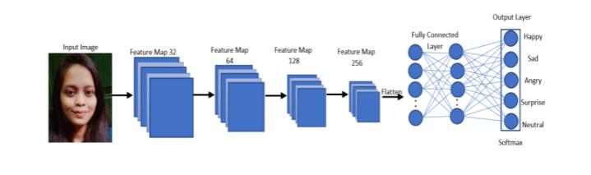
CNN ARCHITECTURE

Slide 10
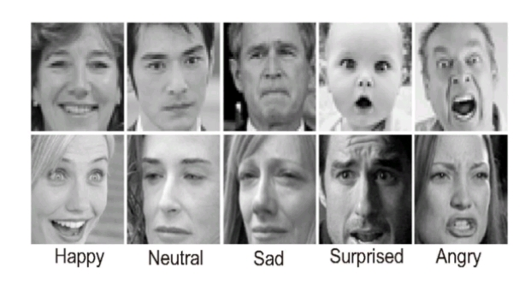
EMOTION DETECTION

Slide 11
SYSTEM CONFIGURATION
HARDWARE REQUIREMENTS:
Processor:Intel Dual Core, I3
Ram:1 GB
Hard Disk:80 GB
SOFTWARE REQUIREMENTS:
Operating System:Windows 7/ XP/8
Front End:Html, css, java script.
Server Side Script:java script.
Database:Mysql

Slide 12
CONCLUSION
This technology will provide a great boom to many things such as the robotics field, which will provide emotions to them.
It allows individuals with Autism Spectrum Disorder (ASD) to enter PCs by processing.
The model could be utilized for various real-life implementations for successful use in sectors such as health, video game and marketing industry.

Slide 13
THANK YOU

